Slide 1


Social
Buzz

Slide 2


Today's agenda
Project recap
Problem
The Analytics team
Process
Insights
Summary

Slide 3

Social Buzz is a fast growing social media unicorn that needs to scale rapidly. Accenture has begun a three – month initial engagement to:
Audit their big data practice.
Provide Recommendations for a Successful IPO.
Analyze of their content categories that highlights the top 5 categories with the largest aggregate popularity.
Project Recap

Slide 4

Problem
Due to rapid growth and the digital nature of their core product, Social Buzz generates and analyzes a massive volume of data daily—over 100,000 pieces of unstructured content including text, images, videos, and GIFs. Managing and maintaining this data requires sophisticated and costly technology. Out of their 250 employees, 200 are dedicated to technical roles, focusing on the complex infrastructure needed to support their operations.

Slide 5



Andrew Fleming
Chief Technology Architect
The Analytics Team
Marcus Rompton
Senior Principal
Yash Patil
Data Analyst

Slide 6
Process
Data Understanding: Understanding the data model and domain of your business.
1
Data Extraction : Architected what an ideal dataset should look like for this problem and extracted it from the relevant data sources
2
Data Modelling : Process and model the data into a dataset that can precisely answer the business questions and product analytics
3
Data Analytics : Use Analytical expertise to uncover insights from the dataset and to produce visualization to describe the insights
4
Recommendations : Use the insights to unlock business decisions and make recommendations on next steps
5

Slide 7

Insights
Photo 6589
25.4 %
Animals
1897
7.74 %
Heart 1622
6.6 %

Slide 8
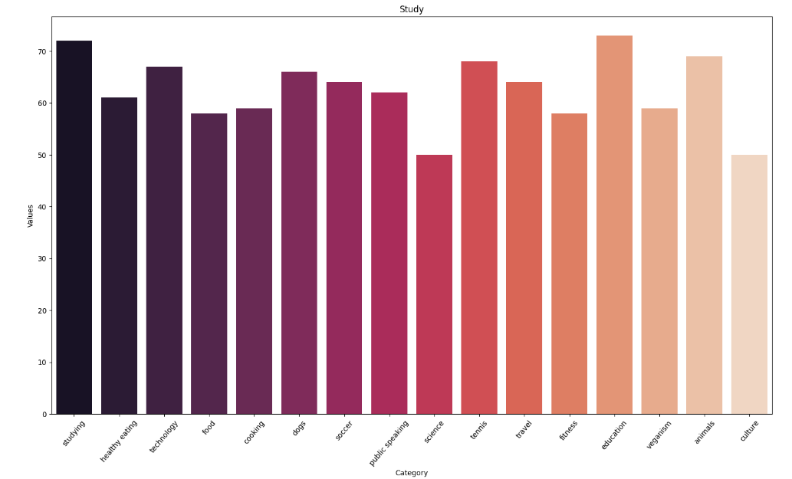

Slide 9
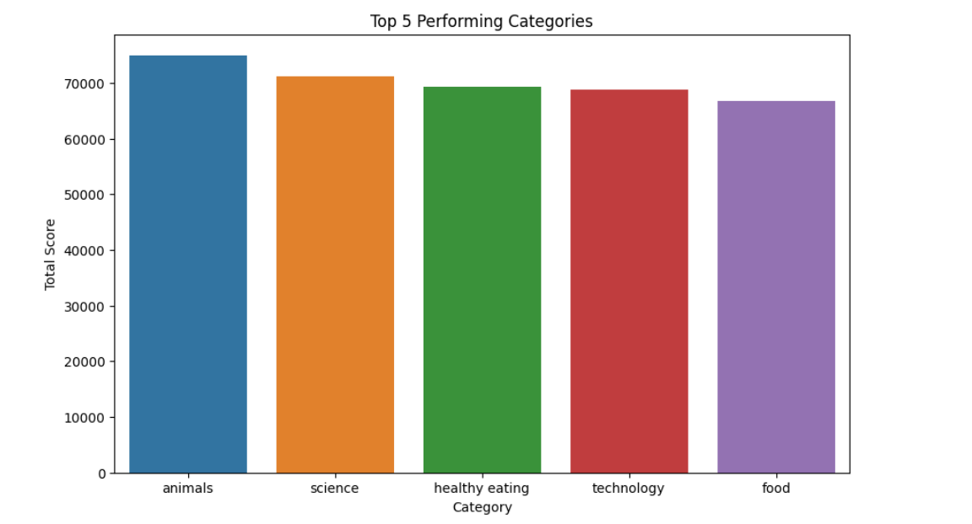
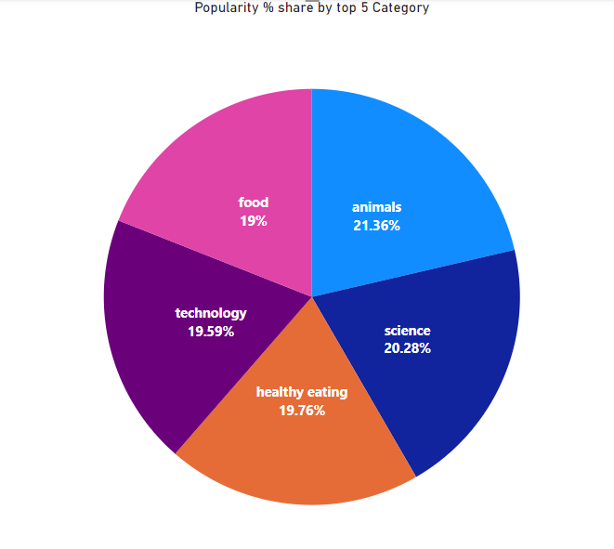

Slide 10
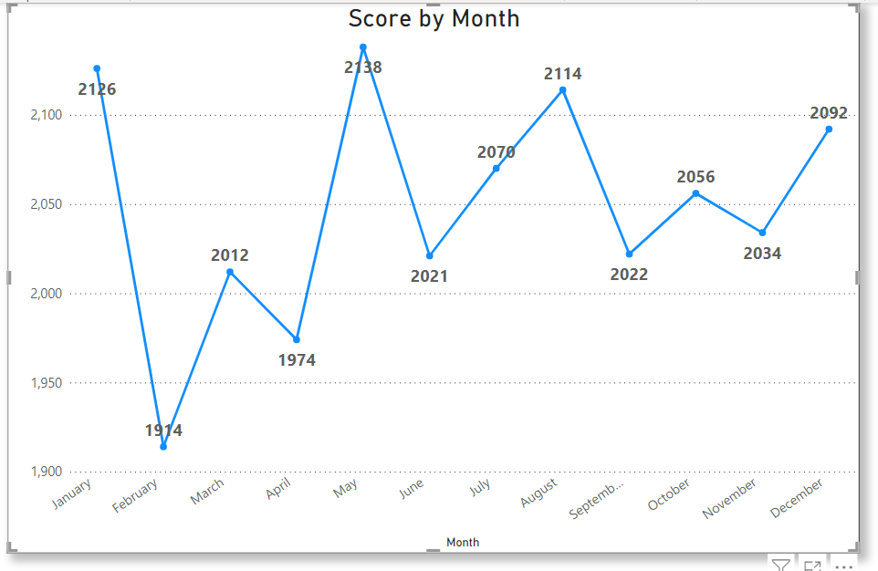

Slide 11

ANALYSIS
Animals and science are two most popular categories of content, showing that people enjoy ‘real-life’ and ‘factual’ content the most.
INSIGHT
Food is the common theme with the top 5 categories with ‘Healthy Eating’ ranking the highest. This may give an indication to the audience within your user base. You could use this insight to create a campaign and work with healthy eating brands to boost user engagement.
NEXT STEPS
This ad-hoc analysis is insightful,but it’s time to take this analysis into large scale production for real-time understanding your business.
Summary

Slide 12
Thank you!
ANY QUESTIONS?

